Slide 1
Exploring the Radio Spectrum with an RTL-SDR

Slide 2
What is Software-Defined-Radio
Software Defined Radio is radio that is determined by software, as opposed to “hardware radio”. Fixed radio can only tune to a specific frequency and/or protocol (AM/FM car stereo, Ham Radio, Walkie-talkie.) With software-defined-radio, software can be written to tune to specific frequencies the SDR supports and can decode traffic.
RTL-SDR (receive only, 24 – 1700 MHz)
HackRF (send and receive half-duplex, 1 – 6000 MHz)
BladeRF (Send and receive full duplex, 70 – 6000 MHZ)
USRP (Many different models up to 6GHz)
FunCube Pro Dongle (receive only, 150kHz to 1.9GHz)
AirSpy (multiple models)

Slide 3
The RTL-SDR
Originally a DVB-T tuner for watching television. It was discovered it supported a large frequency range, with could be used with a custom driver.
RTL-SDR uses the R820T/R820T2 driver, which supports Frequency Range of 24 – 1766 MHz.
An experimental driver from https://github.com/mutability/rtl-sdr/ supports frequency range of 13 – 1864 MHz.
Some older RTL-SDRs use the E4000 driver and support 55MHz to 2300 MHz. These are more rare and expensive.

Slide 4
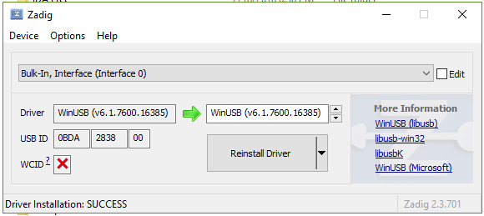
Getting Started with the RTL-SDR
Windows Users can use Zadig to replace the driver of their RTL-SDR
Linux/OS X users need the librtlsdr package, which is included in most package managers:
apt-get install librtlsdr0 librtlsdr-dev rtl-sdr
The RTL-SDR package is also included in HomeBrew for OS X users:
brew install rtl-sdr
The RTL-SDR works natively with Windows 8.1+ (sometimes), though it is best to use the driver supplied by Zadig. Download the Zadig tool and install the WinUSB driver on Bulk-Interface 0/1.

Slide 5
Viewing the Spectrum
While you can use the command line to tune to frequencies, but it is far better to use a spectrum analyzer for ease of use and visual aid.
For Windows, I recommend SDRSharp (SDR#). Downloading the SDRSharp zip file includes the Zadig utility to replace your driver.
https://airspy.com/download/
For Linux and OS X, I recommend GQRX. You can get this from some package managers, or directly from: http://gqrx.dk/
While they are two different tools they basically do the same thing.

Slide 6
Spectrum Demo
We’ll be using SDR# to tune to FM radio and NOAA weather 162.400 .

Slide 7
Spectrum Scanner
Spectrum Analyzer like SDR# and GQRX can only view so much of the frequency at once. Other tools exist that allow us to quickly scan the frequency range to find something interesting.
RTLSDR-Scanner is a convenient and well written tool that allows you to do so.
Available at https://github.com/EarToEarOak/RTLSDR-Scanner
Written in Python, so cross-platform
Can also be downloading use pip

Slide 8
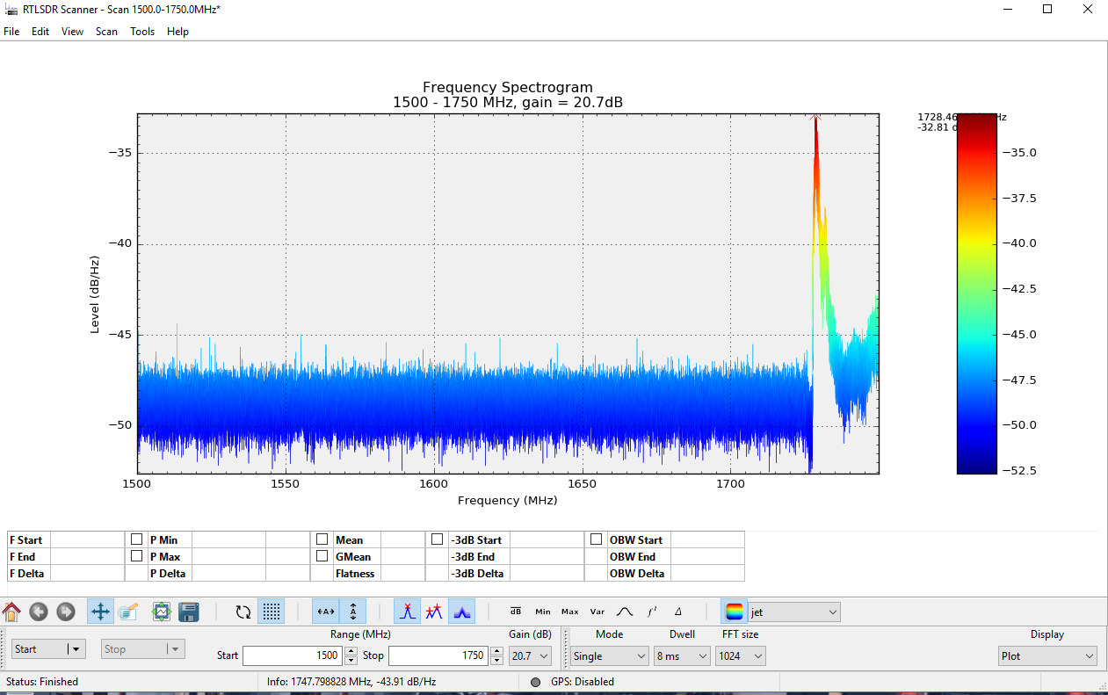
RTLSDR-Scanner

Slide 9
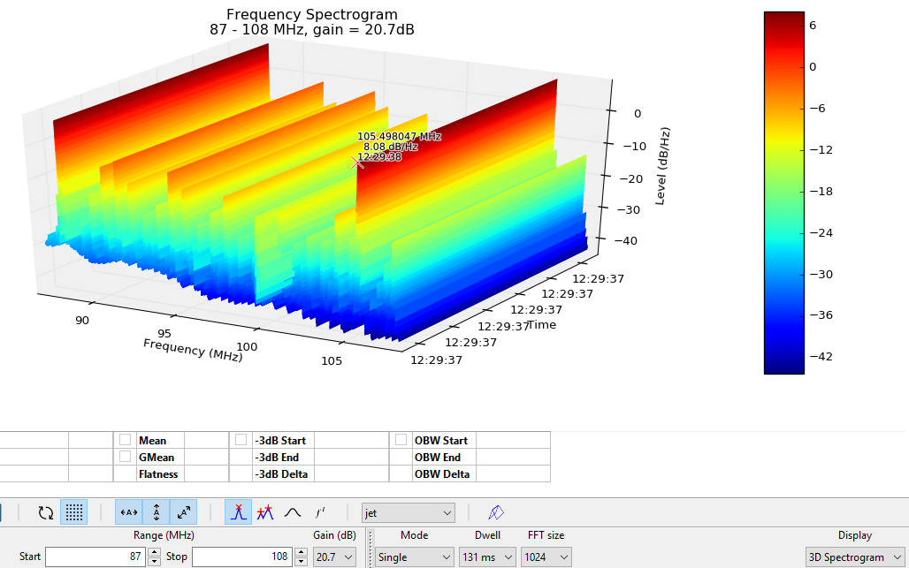
RTLSDR-Scanner

Slide 10
Ethics
Ethics are important.
While the RTL-SDR is only receive only device, you should be ethical in how you use it.

Slide 11
Airplane Traffic: ADS-B 1090Mhz
Airplanes are constantly transmitting signals about their flight number and direction and position, known as ADS-B (Automatic dependent surveillance—broadcast). This is sent at 1090 MHz. There are many, many SDR tools that can decode this traffic.
All sent in plaintext
No authentication
Can be spoofed (plz don’t)
I will use dump1090 to decode traffic since it is simple to use and support on Linux and Windows. Download here:
https://github.com/antirez/dump1090
https://github.com/MalcolmRobb/dump1090 (Windows)
Also available in the kali repository.
Other airplane signals include UAT (universal Access Transceiver, 978 MHz), and ACARS (Aircraft Communications Addressing and Reporting System 129 – 137MHz)

Slide 12
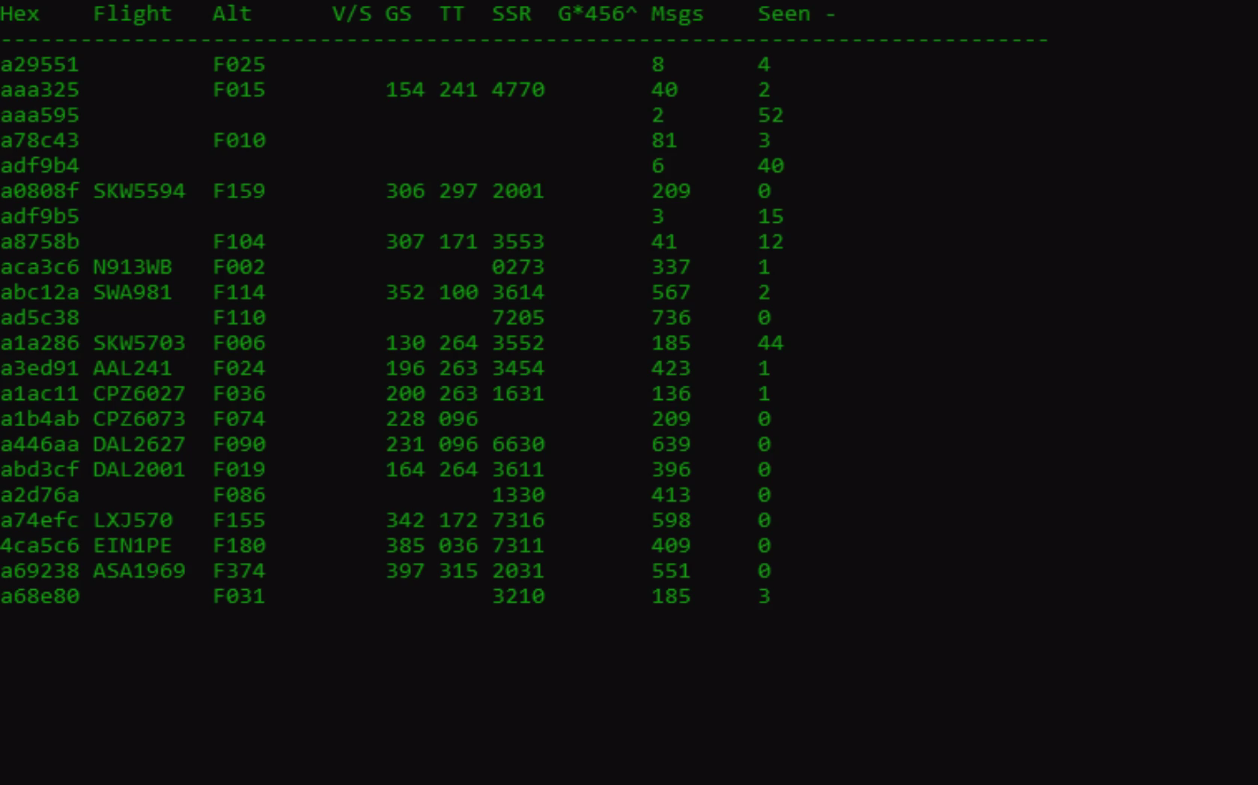
Dump1090 --interactive --net

Slide 13
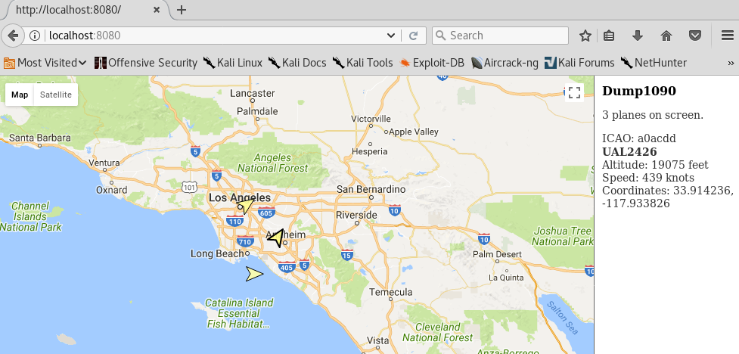
Dump1090 --interactive --net

Slide 14
Emergency Services
A lot of emergency services transmit communications around 460 – 480 MHz, 500 MHz, and 860 MHz.
This includes:
Dispatch
Fire/EMS
Paramedic Base Hospital System
Lifeguards
Disaster Communications
Custody Operations
Court Services
Emergency services use what a Trunked Radio System. Think of it like a packet-switched network for radios, using a client-server model. The data/control channel is the brain of the system. Users are assigned TalkIDs for Fire, Police, etc. When a user pushes the talk button on their radio, the request is made to the control channel. The control channel chooses an unused frequency from its frequency pool and sends that data to all the radios that are set to the TalkID of the originating unit.
More info at: http://wiki.radioreference.com/index.php/Trunking_Basics

Slide 15
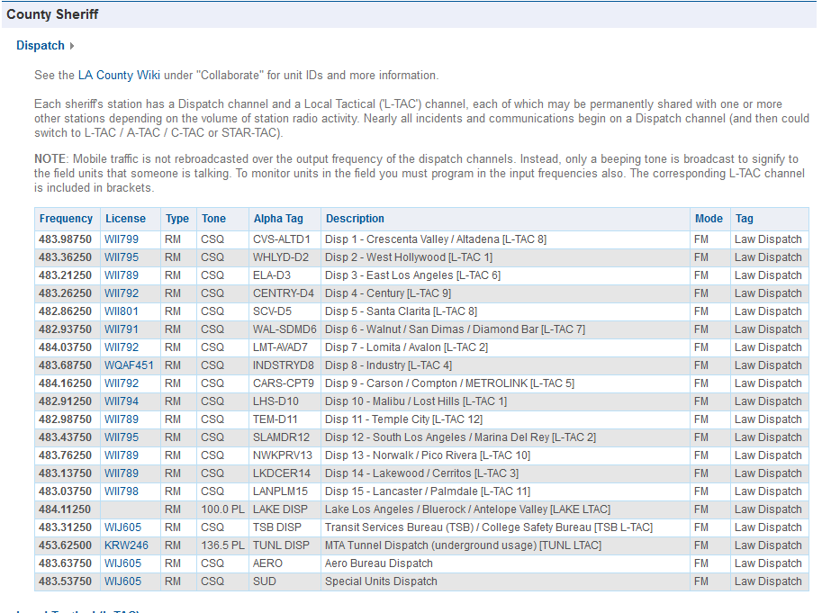
Radioreference.com

Slide 16
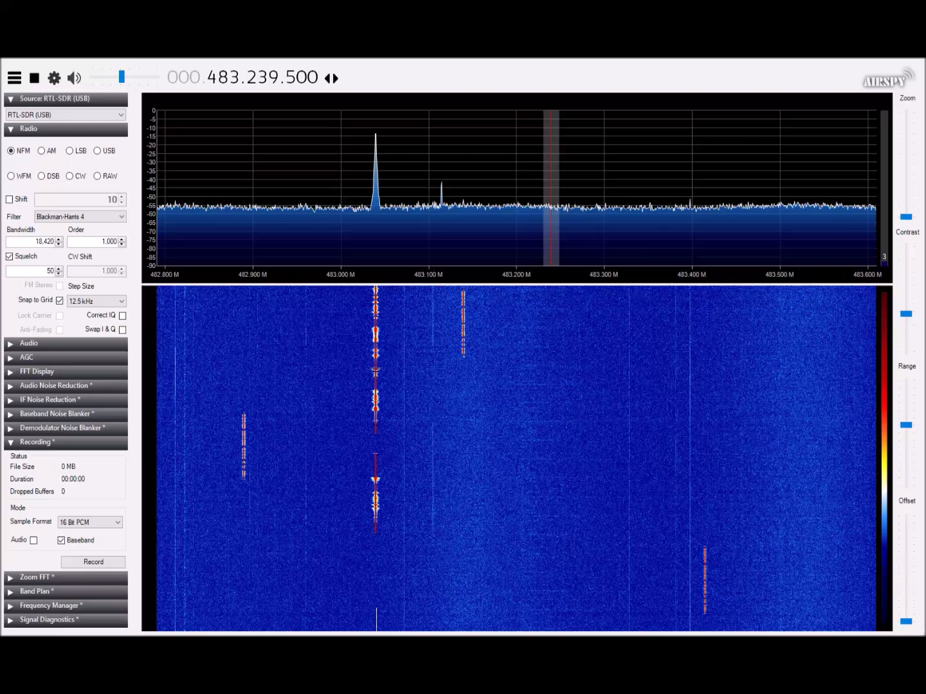
Emergency Services

Slide 17
Emergency Services
Many systems still use Analog, so they do not need to be digital decoded.
P25 (ACPO-25) is a popular Digital encoder used by emergency services, and thus additional software is needed to decode it.
Popular software:
DSD+ (2 dongles)
Unitrunker (2 dongles)
SDRTrunk (1 dongles)

Slide 18
ERT Smart Utility Meters
Utilities often use "smart meters" to optimize their residential meter reading infrastructure. Smart meters transmit consumption information in the various ISM bands allowing utilities to simply send readers driving through neighborhoods to collect commodity consumption information. One protocol in particular: Encoder Receiver Transmitter by Itron is fairly straight forward to decode and operates in the 900MHz ISM band. – rtlamr GitHub
https://github.com/bemasher/rtlamr
Works for both Windows and Linux

Slide 19
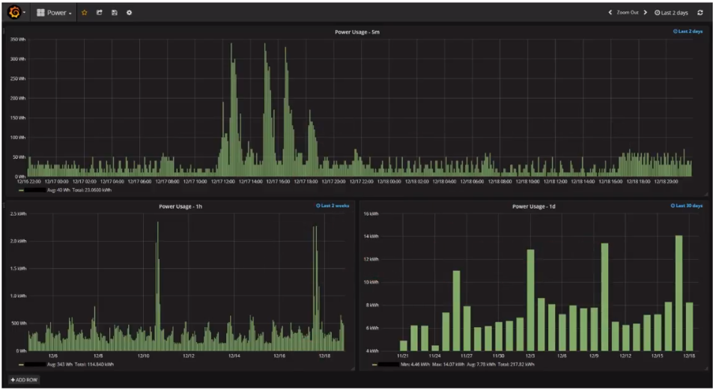
ERT Smart Utility Meters

Slide 20
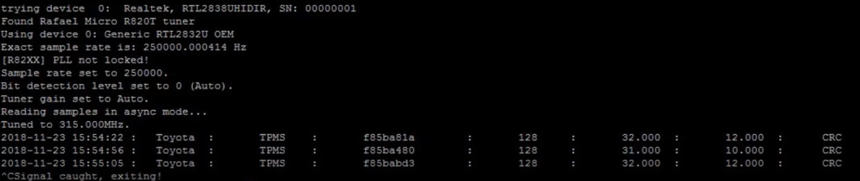
TPMS – Tire Pressure Monitor System
In 2008 Congress mandated that all new tires include wireless TPMS. With this, tire pressure can be read wirelessly for the purpose of safety and ease of use.
Downside: No encryption, every tire has a unique code. This can be used to spy on someone’s driving habits and location.
Usually transmits on 315 MHz or 433 Mhz. You can use rtl_433 to decode some manufacturers’ TPMS encoding.
https://github.com/merbanan/rtl_433

Slide 21
Wireless Pagers
Despite their age, wireless pagers are still in use today, especially by hospitals. Pagers will usually use one of three protocols:
POCSAG (Post Office Code Standardization Advisory Group)
FLEX (Flexible Wide Area Paging Protocol)
ERMES (European Radio Message System)
In America pager signals can bee seen around 929 – 931MHz, with some around 450 MHz. I have only seen FLEX where I live, and POCSAG is common in UK, Europe, some places in America. ERMES is sparsely used in a few European countries.
Tools:
PDW (Pager Decoder for Windows)
Multimon-ng (Linux)
You will need to pipe audio into the decoder. This can be done via Line-in to Audio out, Stereo Mixer, VB-Cable, pulseaudio, etc.

Slide 22
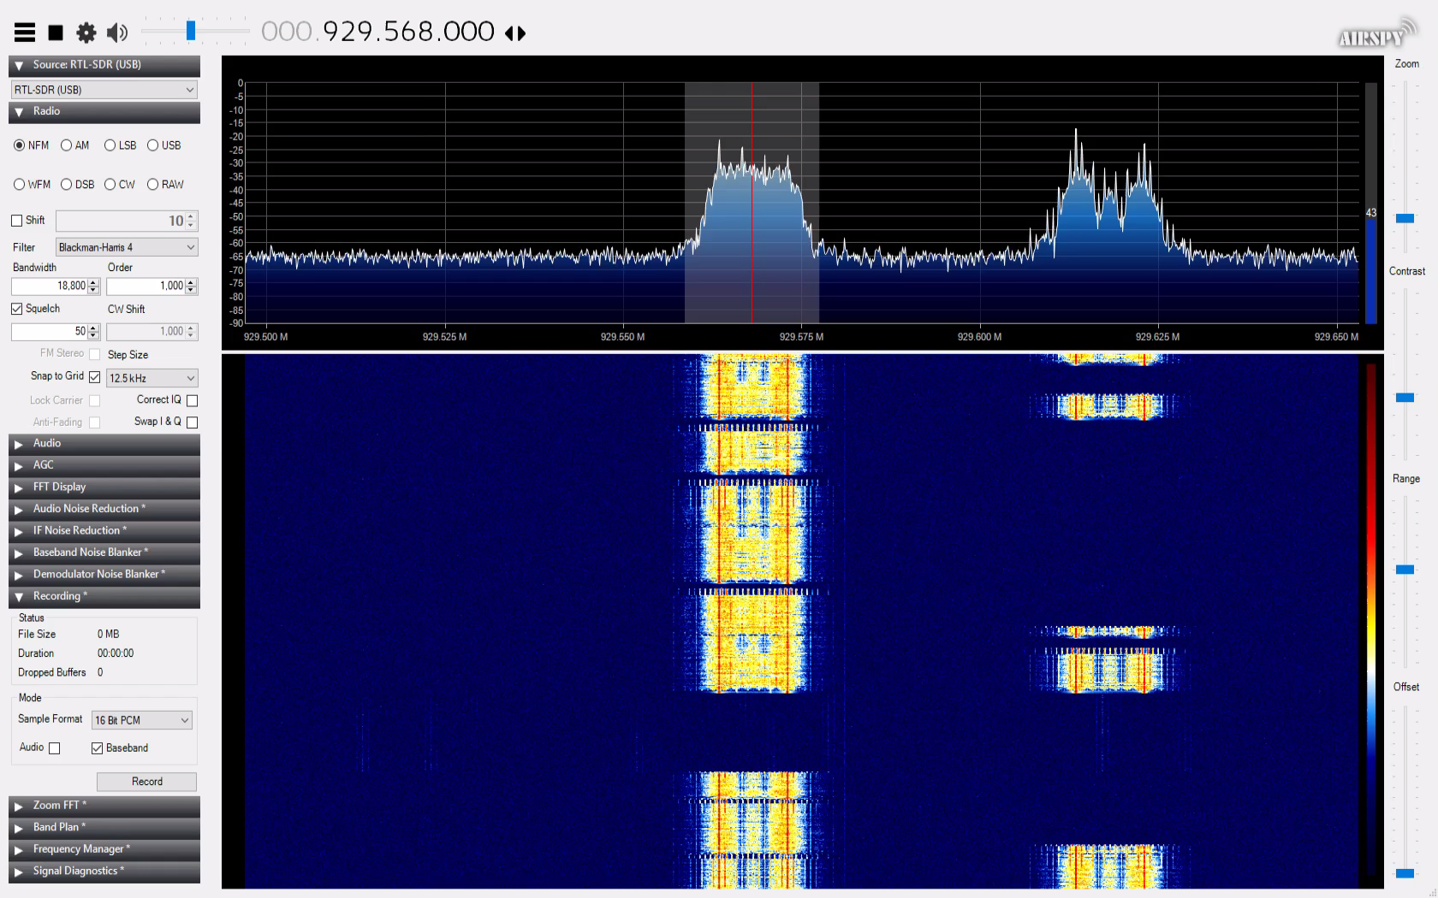
Wireless Pagers
Usually best to find a signal in SDR#/GQRX first. Below is what a FLEX pager sounds like:

Slide 23
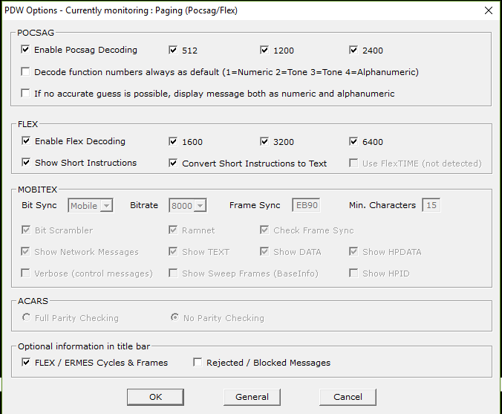
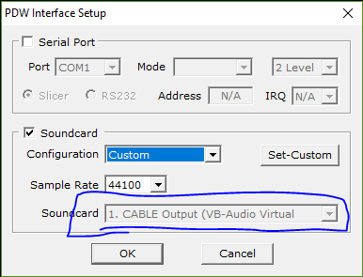
Setting up PDW
Make sure that interface setting is set to your soundcard or virtual cable, and that POCSAG and FLEX are checked off:

Slide 24
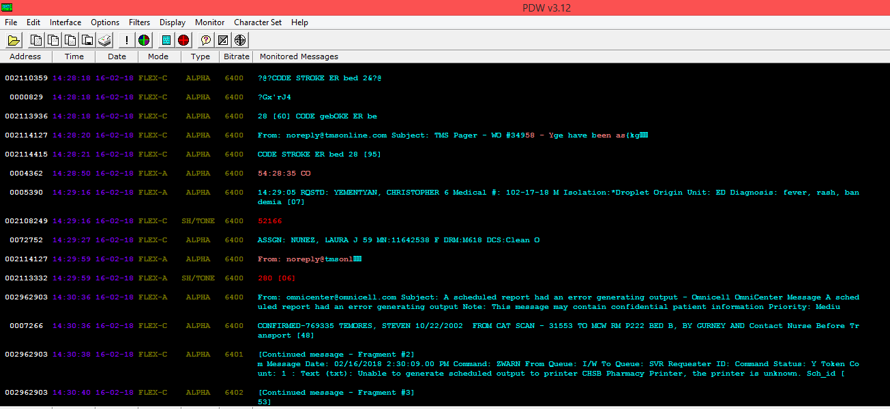
Setting up PDW
Decoding will occur automatically if you are tuned to a Pager signal. You tune to the signal with your spectrum analyzer, not PDW itself.

Slide 25

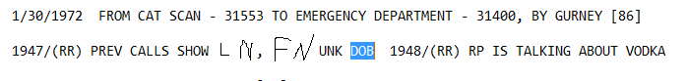

Juicy stuff found
Many Pagers are unencrypted, Though FLEX does support encryption, it was not being used at my local hospital. If you listen long enough, you can find PII.

Slide 26
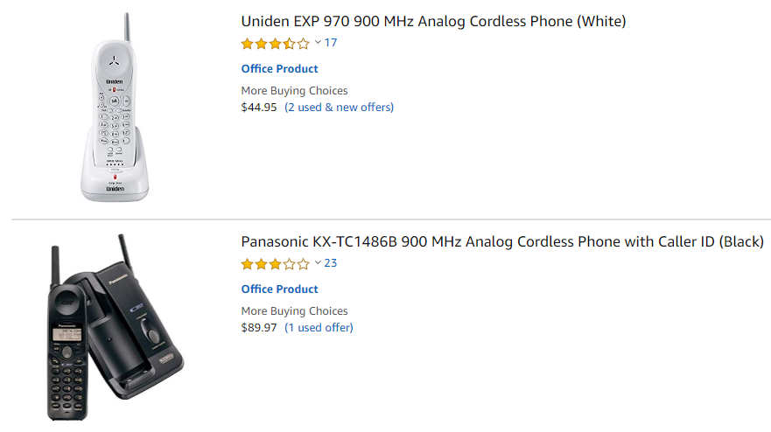
Cordless Phones
Many cordless phones use DECT 6.0 in America, which occurs at 1.9 GHz. This is outside the range of the R820T/2 driver but is possible to listen to using an E4000 model. Aside from DECT, many cordless phones will use the ISM bands (900MHz, 2.4GHz, 5.GHz). 900MHz is within the range of the RTL-SDR.
Many of these phones use no encryption, and some are not even digital encoded, meaning you can listen to phone calls with just a spectrum analyzer.

Slide 27
Cell Phones – ISMI Catcher
IMSI-catcher is a MITM attack against cell phones.
The IMSI is the international mobile subscriber identity, and unique identifies users of a cell network.
An IMSI catcher attacks as a fake mobile tower between a phone and real cell tower.
Often used by law enforcement and intelligence agencies.
Might be illegal depending on local laws.
Might be detectable.
The RTL-SDR and other SDRs can be used as IMSI catchers.
https://github.com/Oros42/IMSI-catcher

Slide 28
Cell Phones - IMSI
IMSI Structure
123 99 123456790
MCC MNC MSIN
MMC – Mobile Country Code
MNC – Mobile Network Code
MSIN – Mobile Subscriber Identification Number
Most Traffic will be encrypted, however A5/1 Encryption has known rainbow tables, and A5/0 has no encryption.

Slide 29
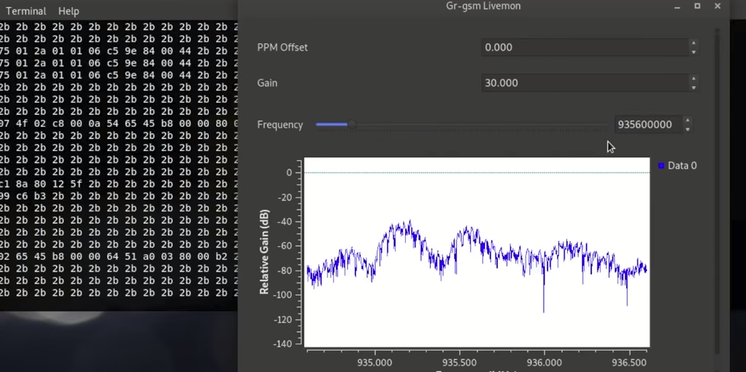
Cell Phones - IMSI
IMSI – Catcher leverages gnu-radio and the gr-gsm module. Start with tuning to around 935 MHz and adjust until data is decoded in the terminal

Slide 30
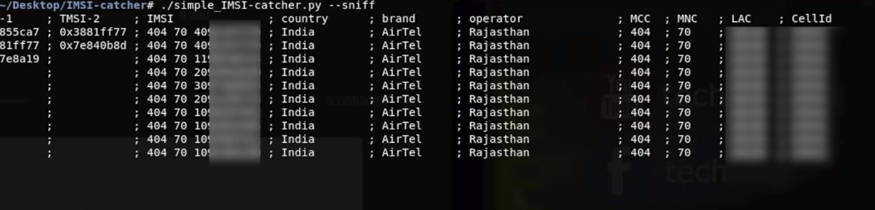
Cell Phones - IMSI
Open a new terminal and use sniff with the IMSI catcher.
You will be able to see various cell phone metadata.
LAC = location area, set of base stations that are grouped together to optimize signaling.
CellID = Unique number used to identify each base transceiver station (BTS) or sector of a BTS within a location area code (LAC) if not within a GSM network.

Slide 31
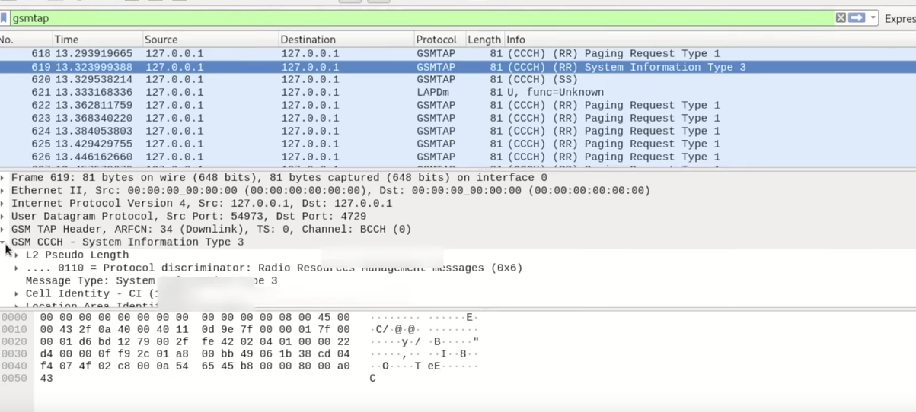
Cell Phones - IMSI
GSM data can be viewed in WireShark

Slide 32
Closing
There’s more to Wireless then just Wi-Fi
If performing a pent-test or vulnerability assessment, other radio maybe valuable:
Example: Pen testing a hospital
Example: Exterior guards using unencrypted Radios
Example: Anywhere with cordless phones
Helpful Resources:
Rtl-sdr.com
Radioreference.com
https://www.sigidwiki.com/
The Hobbyist’s Guide to the RTL-SDR
Buy an RTL-SDR at https://hackerwarehouse.com/product/rtlsdr/

